Slide 1
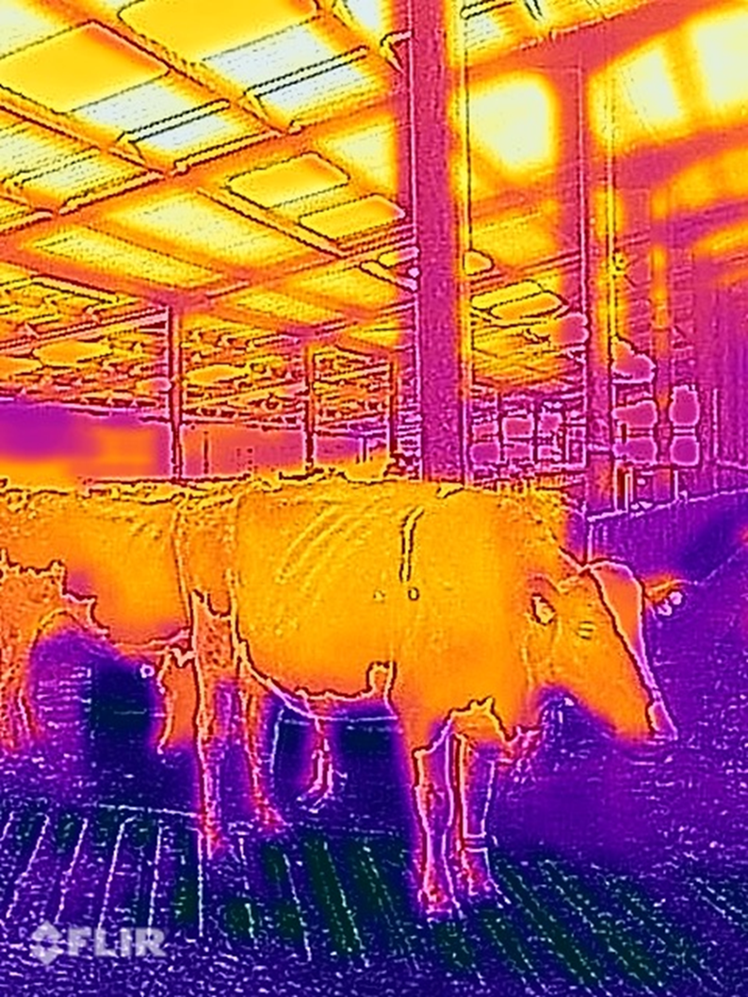
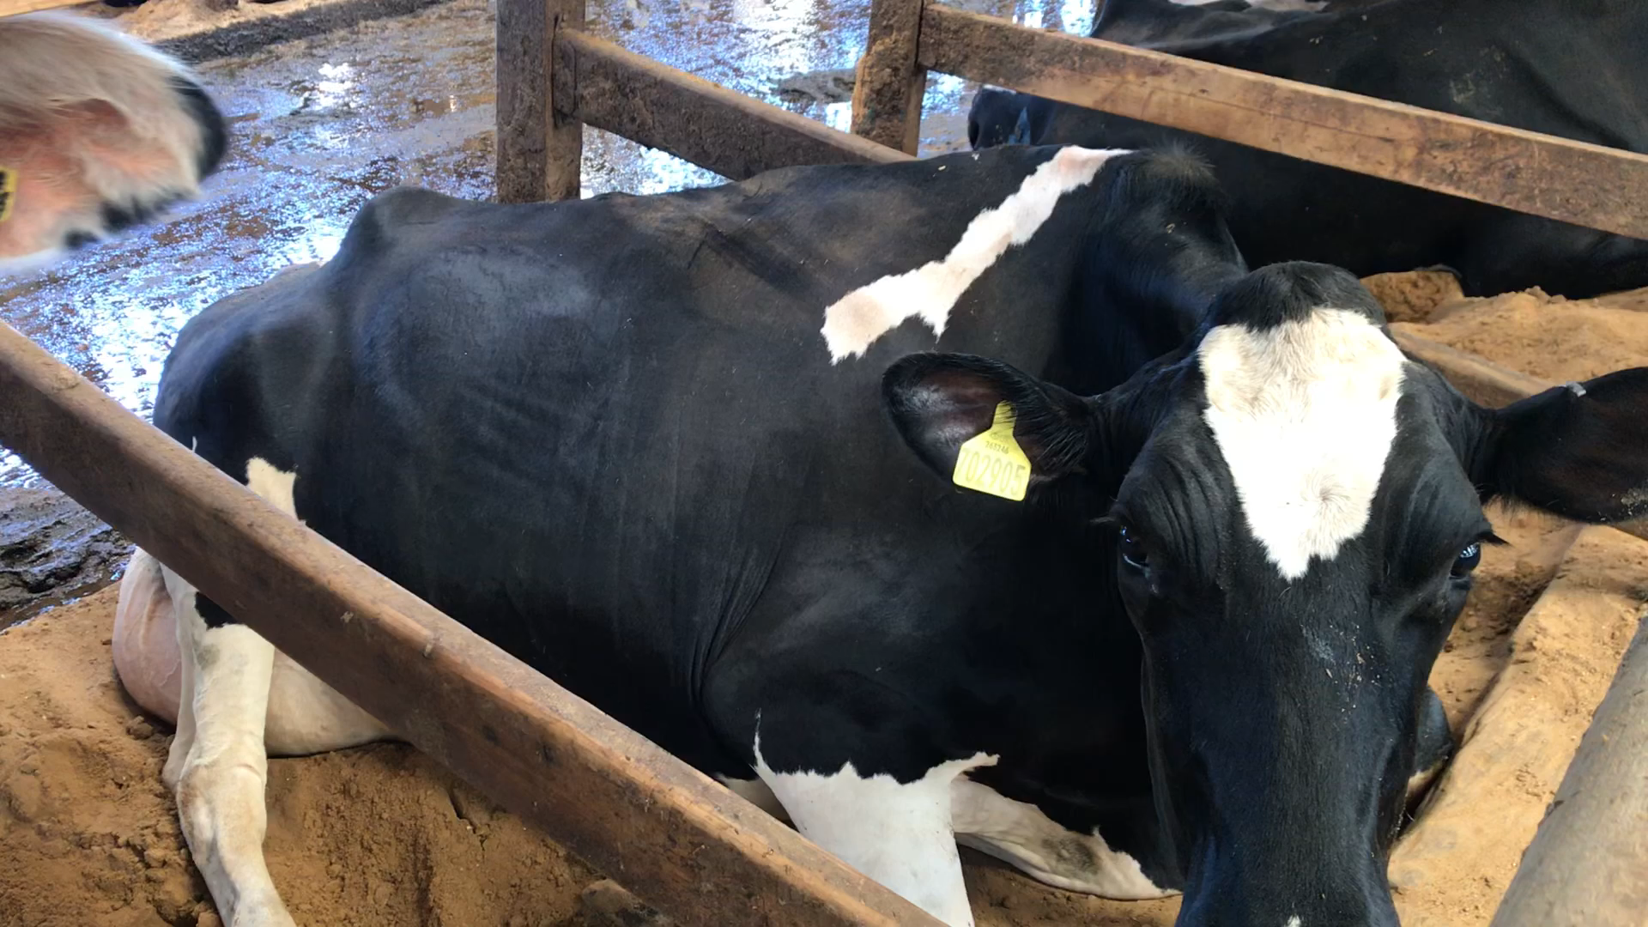
Heat stress in dairy cows: Development of non-invasive biofeedback systems for real-time monitoring and assessment on commercial farms in UK.
Tom Chamberlain
MRes studies
22394500@live.harper.ac.uk

Slide 2
Who am I?
Trained as a veterinary surgeon: Bristol University
Career working with dairy cattle
Academia
In practice
1990’s – 2010’s: Early nutrition courses and software
2010’s onwards: NMR milk record analysis and visualisation for feed trade
2023: 1st year of MSc in Data Science
Live near Southampton
Mainly working remotely

Slide 3


Project background
2020-23. Grazing project to eat more grass
Encouraging cows to eat in hot time of day
Seemed to compromise cow welfare
2021-2023
Project funded by Lallemand Animal Nutrition
Aims
Assess heat stress risk on UK farms
Raise public/farmer awareness of heat stress
Realised the current assessments not very good
2022
Enrolled for HAU Data Science MSc
Started collecting farm data

Slide 4
Masters studies progress
2022 – enrolled for PGCert/MSc in Data Science
Completed first four compulsory modules
Spring 2023 Changed to MRes (part time)
Summer 2023 Data collection : Phase I
Winter 2023 : Intentions
Refine project ideas, start data processing
Develop new predictive models
Summer 2024 Data collection : Phase II
Winter 2024. complete analyses and write up
SO: very much a work in progress – ideas please

Slide 5
Two parts
Wednesday HARUG group
Progress so far
The software and hardware systems used to collect data
Data handling and presentation for public engagement
Friday – lab meeting
Ideas for future work
Best ways to analyse the data
Aims and objectives
POC analyses
What other approaches?

Slide 6
Outline
Why is heat stress important?
How is it measured?
Limitations
Main hypothesis for cow-based measurement
POC investigations
“If you can’t see it in the data will be difficult to model”
Data collection methods
Data sets available
Request – ideas for approaches to develop model
Limitations (edge processing on commercial farms)

Slide 7
What is heat stress?
Excessive heat accumulation
Balance between
Heat production and heat inputs
Animal’s ability to lose heat
Problem for both Grazing and Housed cows

Slide 8
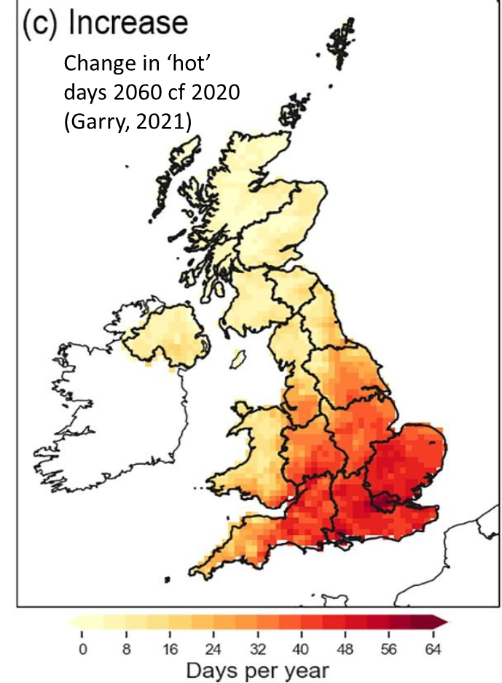
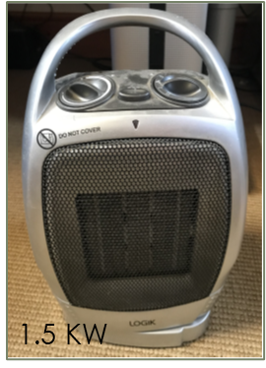
Why heat stress is a growing problem?
Global warming
Average temperatures rising
Number of extreme days rising
Best case scenario: will over-shoot +1.5’C then drop back again
Rising milk yields
Increasing metabolic heat production
40 l/day heat output is
18 fold greater than human
More than a small office heater
Activity | KW heat output
20 l/day | 1.22
40 l/day | 1.61
60 l/day | 2.00
40 weeks pregnant | 1.27
Human | 0.09
x18
From FiM, 2004
Purwanto, 2014

Slide 9
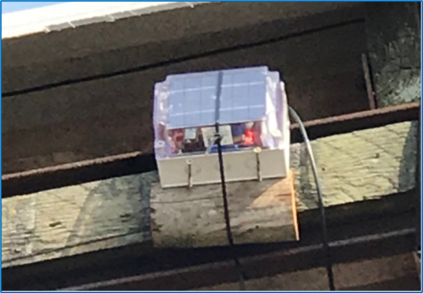
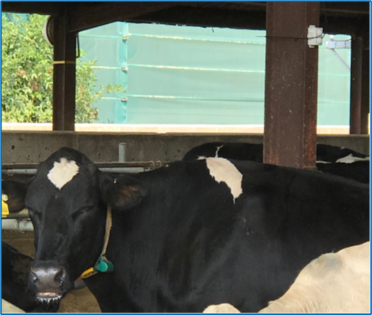
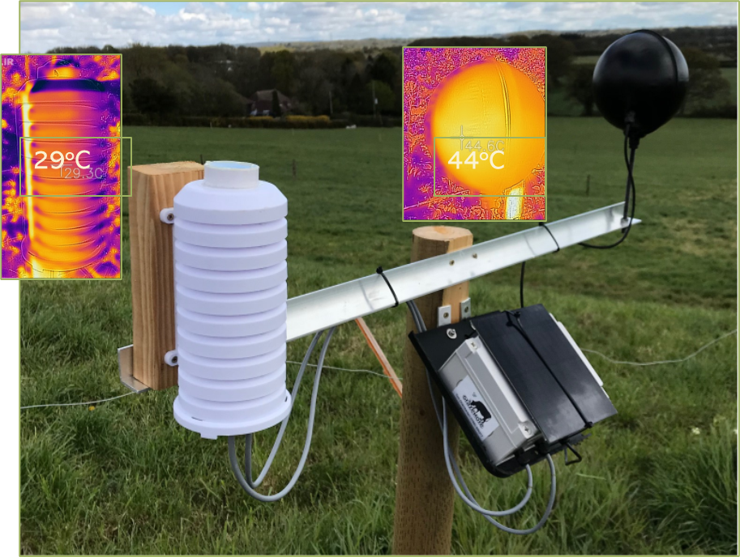
Current methods for measuring heat stress
Inside cattle sheds
THI ~ temperature + relative humidity (NRC, 1972)
Grazing situation
DHLI ~ BlackGlobe temperature + relative humidity (Lee, 2017,QLD, Australia)
THI – Temperature Humidity Index
DHLI – Dairy Heat Load Index

Slide 10
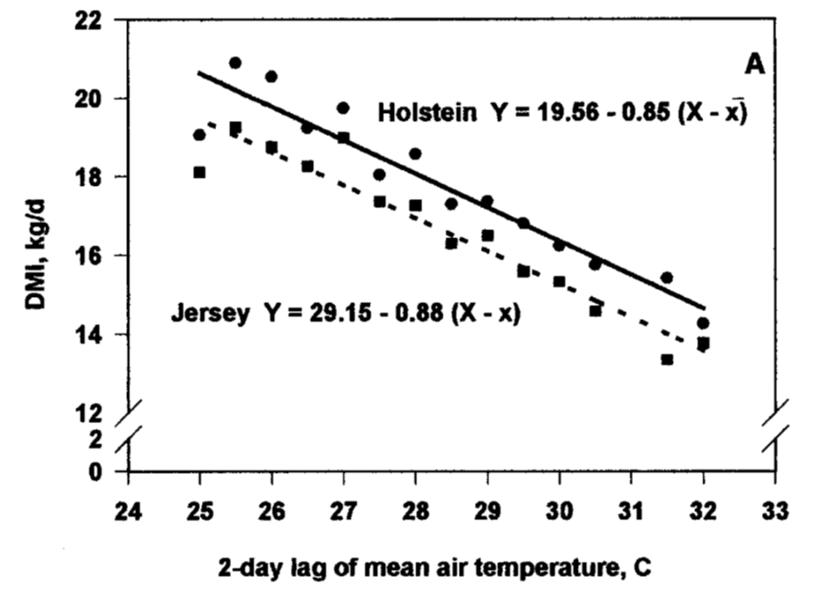
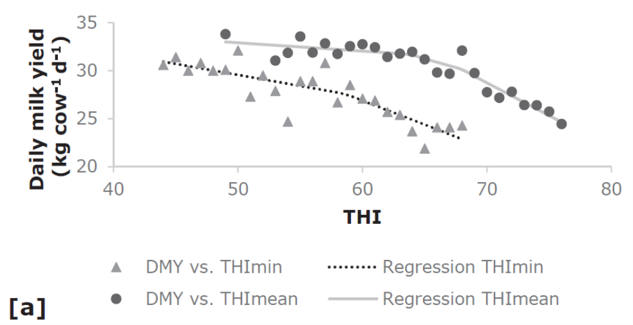
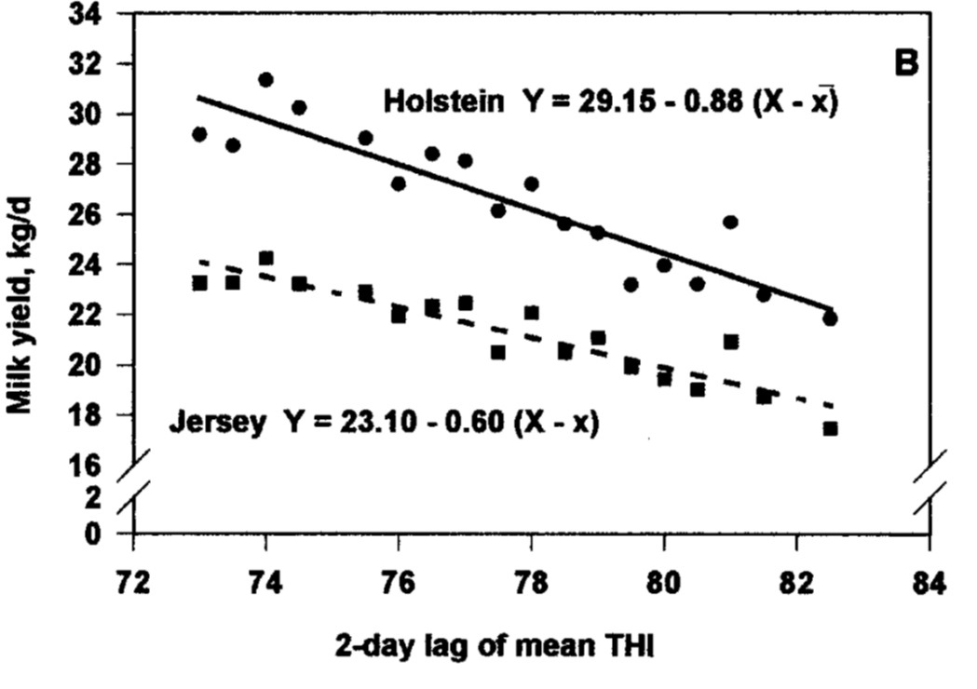
Effects of heat stress Reduced feed intake – reduced milk output
Fall in intake only accounts for 50% of milk yield drop
~1 kg glucose ‘lost’ in balance trials (Baumgard,2020)
intestinal inflammatory response
Signs of broken-stick response - threshold
Li, 2019, QLD, AU
West, 2003, GA, USA

Slide 11
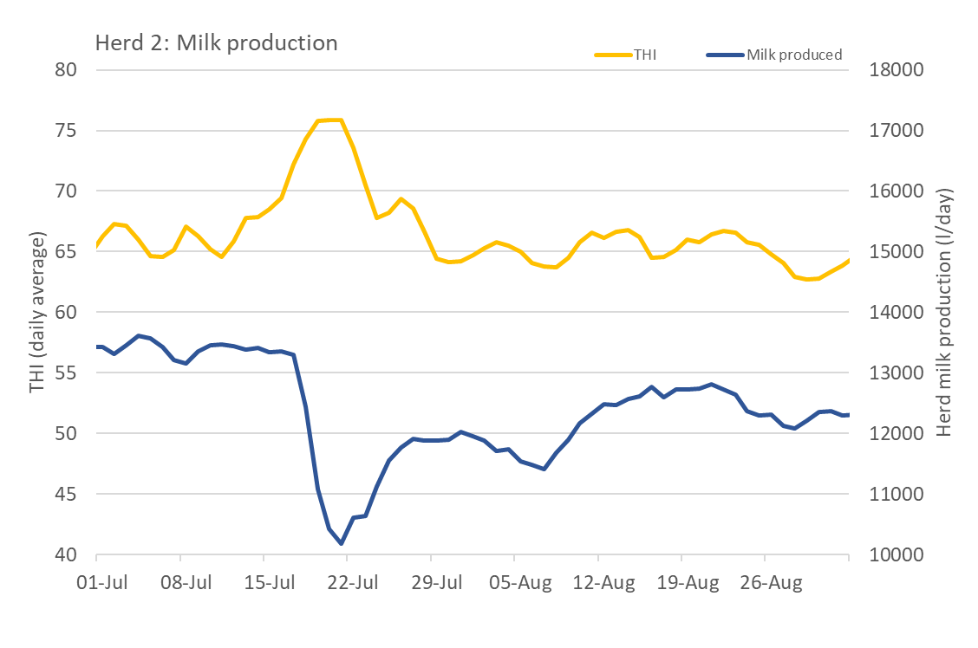
Effects of heat stress - Britain Reduced feed intake – reduced milk output
Reading, Berks
Lost 3000 l/day
£1000/day in milk
2 day lag in milk drop
Lost 3,000 l/day
(400 cows)

Slide 12
Increased respiration rate
11:00 am 16 June 2021
27ºC, 48% RH
Short term THI : 73
24 hr average THI : 66
RR : 92/min
Not ruminating
Trigger threshold: Resp rate over 60 / minute

Slide 13
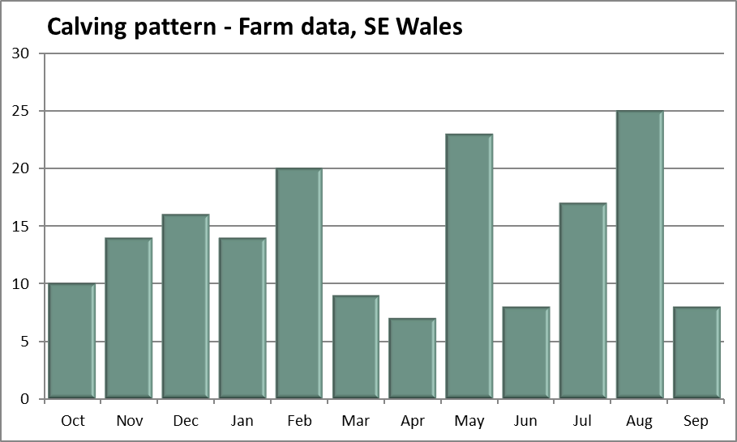
On farm impact on fertility - GB Effect on calving pattern
180 cows, 12k MY
3 robots/AMS
Striving for even calving pattern
Year to Sept22
Mar-Apr 2022
Conceived Jun-Jul 2021
22 July 2021: 32.2’C
Jun 2022
Conceived Sept
8 Sept 2021: 30.7’C
25
Target = 15 cows
12
Own data, HPR analyses, 2022

Slide 14
Measuring heat stress on farms
Data required
Temperature
Humidity
Black Globe temperature
Time stamp, etc
Sampling
Aim: derive an hourly THI/DHLI figure
Over sample at 20 minute intervals
Cannot achieve exact intervals
Median of 3 results gives protection from outliers

Slide 15
Methods for measuring heat stress on farms
Uses the Particle IoT Platform-as-a-service
www.particle.io (based/focused on USA)
System free for moderate use.
$299/mth thereafter
Communicates over cellular (2G/3G) network
Risk = Sunsetting – but system is evolving
3G coverage v wide and easily checked

Slide 16
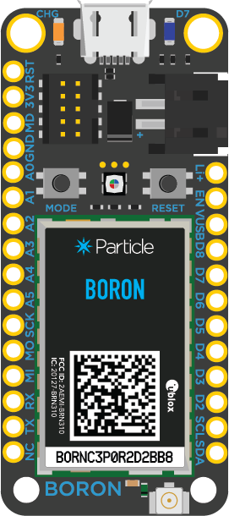
Particle Hardware
Continually evolving (avoid sunsetting etc)
‘too much’ end-user system updating + maintenance
Current device is Boron
ARM Cortex-M4F
1MB flash, 256KB RAM
I2C, SPI, analog (12 bit) and digital I/O
LiPo battery connection + charging + solar
Adafruit Feather specification
Fully wireless certified
No longer available !! (modem changes)

Slide 17
Particle Software (1)
Arduino style C++ programming
Good IDE workbench based on Visual Studio
Uses ‘Libraries’ to integrate with sensors etc.
SHT31 (‘C+RH), BH1750 (Lux), 16Bit ADC, FRAM, etc.
Upload to device over USB or OTA (over the air)
Monitoring progress/debugging
Log through serial monitor in Visual Studio IDE
Via the Particle console

Slide 18
Particle software (2)
Connects to ThingSpeak
(and others)
www.thingspeak.com (part of MatLab)
Maximum of eight variables can be uploaded
Can overload
As often as every 3 minutes
Simple line graphs, etc
Private
Public – share over internet
Archives all data
And much more that I haven't explored

Slide 19
Integration with internet
Live links to own website
www.dchs.info
Now rather minimal
Solar panels need sun!
Real time reporting of results
Clickable maps, etc.
Good for informing farming community
Website maintained using WordPress

Slide 20
THI (and DHLI) limitations
Single / limited monitoring positions
Does not capture cows moving / microclimates
THI only suitable for some housed systems
Not grazing, housed, hybrid,etc.
Not novel roofing materials, etc.
Does not respond to differences in milk yield and metabolic heat production
Fails to capture animal adaptation and genetic variation
Cannot be used to control/optimise mitigation systems
Eg fans, misting, feeding additives

Slide 21
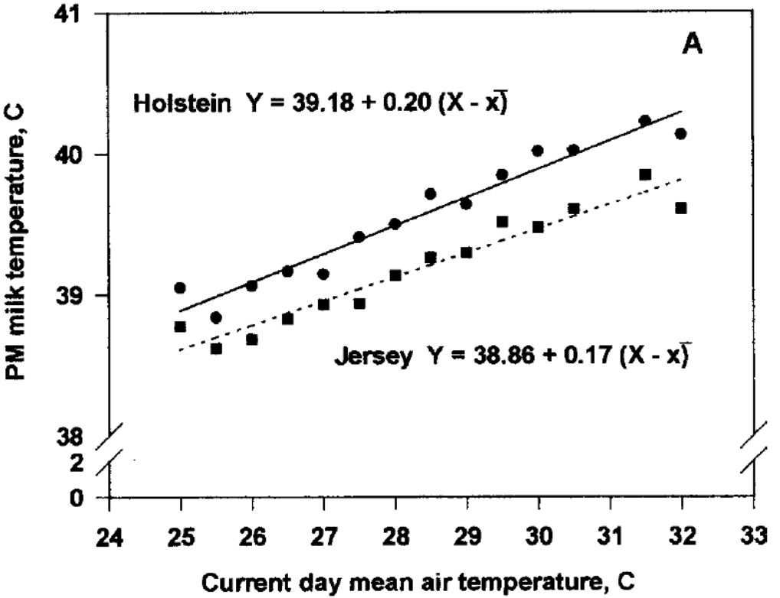
Can we use data from milking parlours?
Temperature of milk in udder same as core body temperature.
An assumption
Ethically difficult to investigate
Easy to measure milk temperature
Milk will cool as it moves through milking plant
Can we characterise and correct for this?
Can we use milk temperature to pick up changes in core body temperature?
West, 2003

Slide 22
Factors affecting milk temperature
Where temperature taken – distance from udder.
Design of parlour
Pipe runs, flow speeds
Amount of milk in pipes
Ambient air temperature
Are first three fixed for a given parlour?
?Only need to consider ambient air temperature

Slide 23
Temperature measuring points Basic milking parlour
A
in udder milk at body temperature
V vulnerable to damage
B
Milk pipe line
Assess 1 – 16 cows
Intermittent flow
May be moving (see next slide)
Variable number of data sources
C
After receiver
Pooled milk flow, full all the time
Often a valved, vertical pipe run
Basic milking parlour
B
C
A

Slide 24
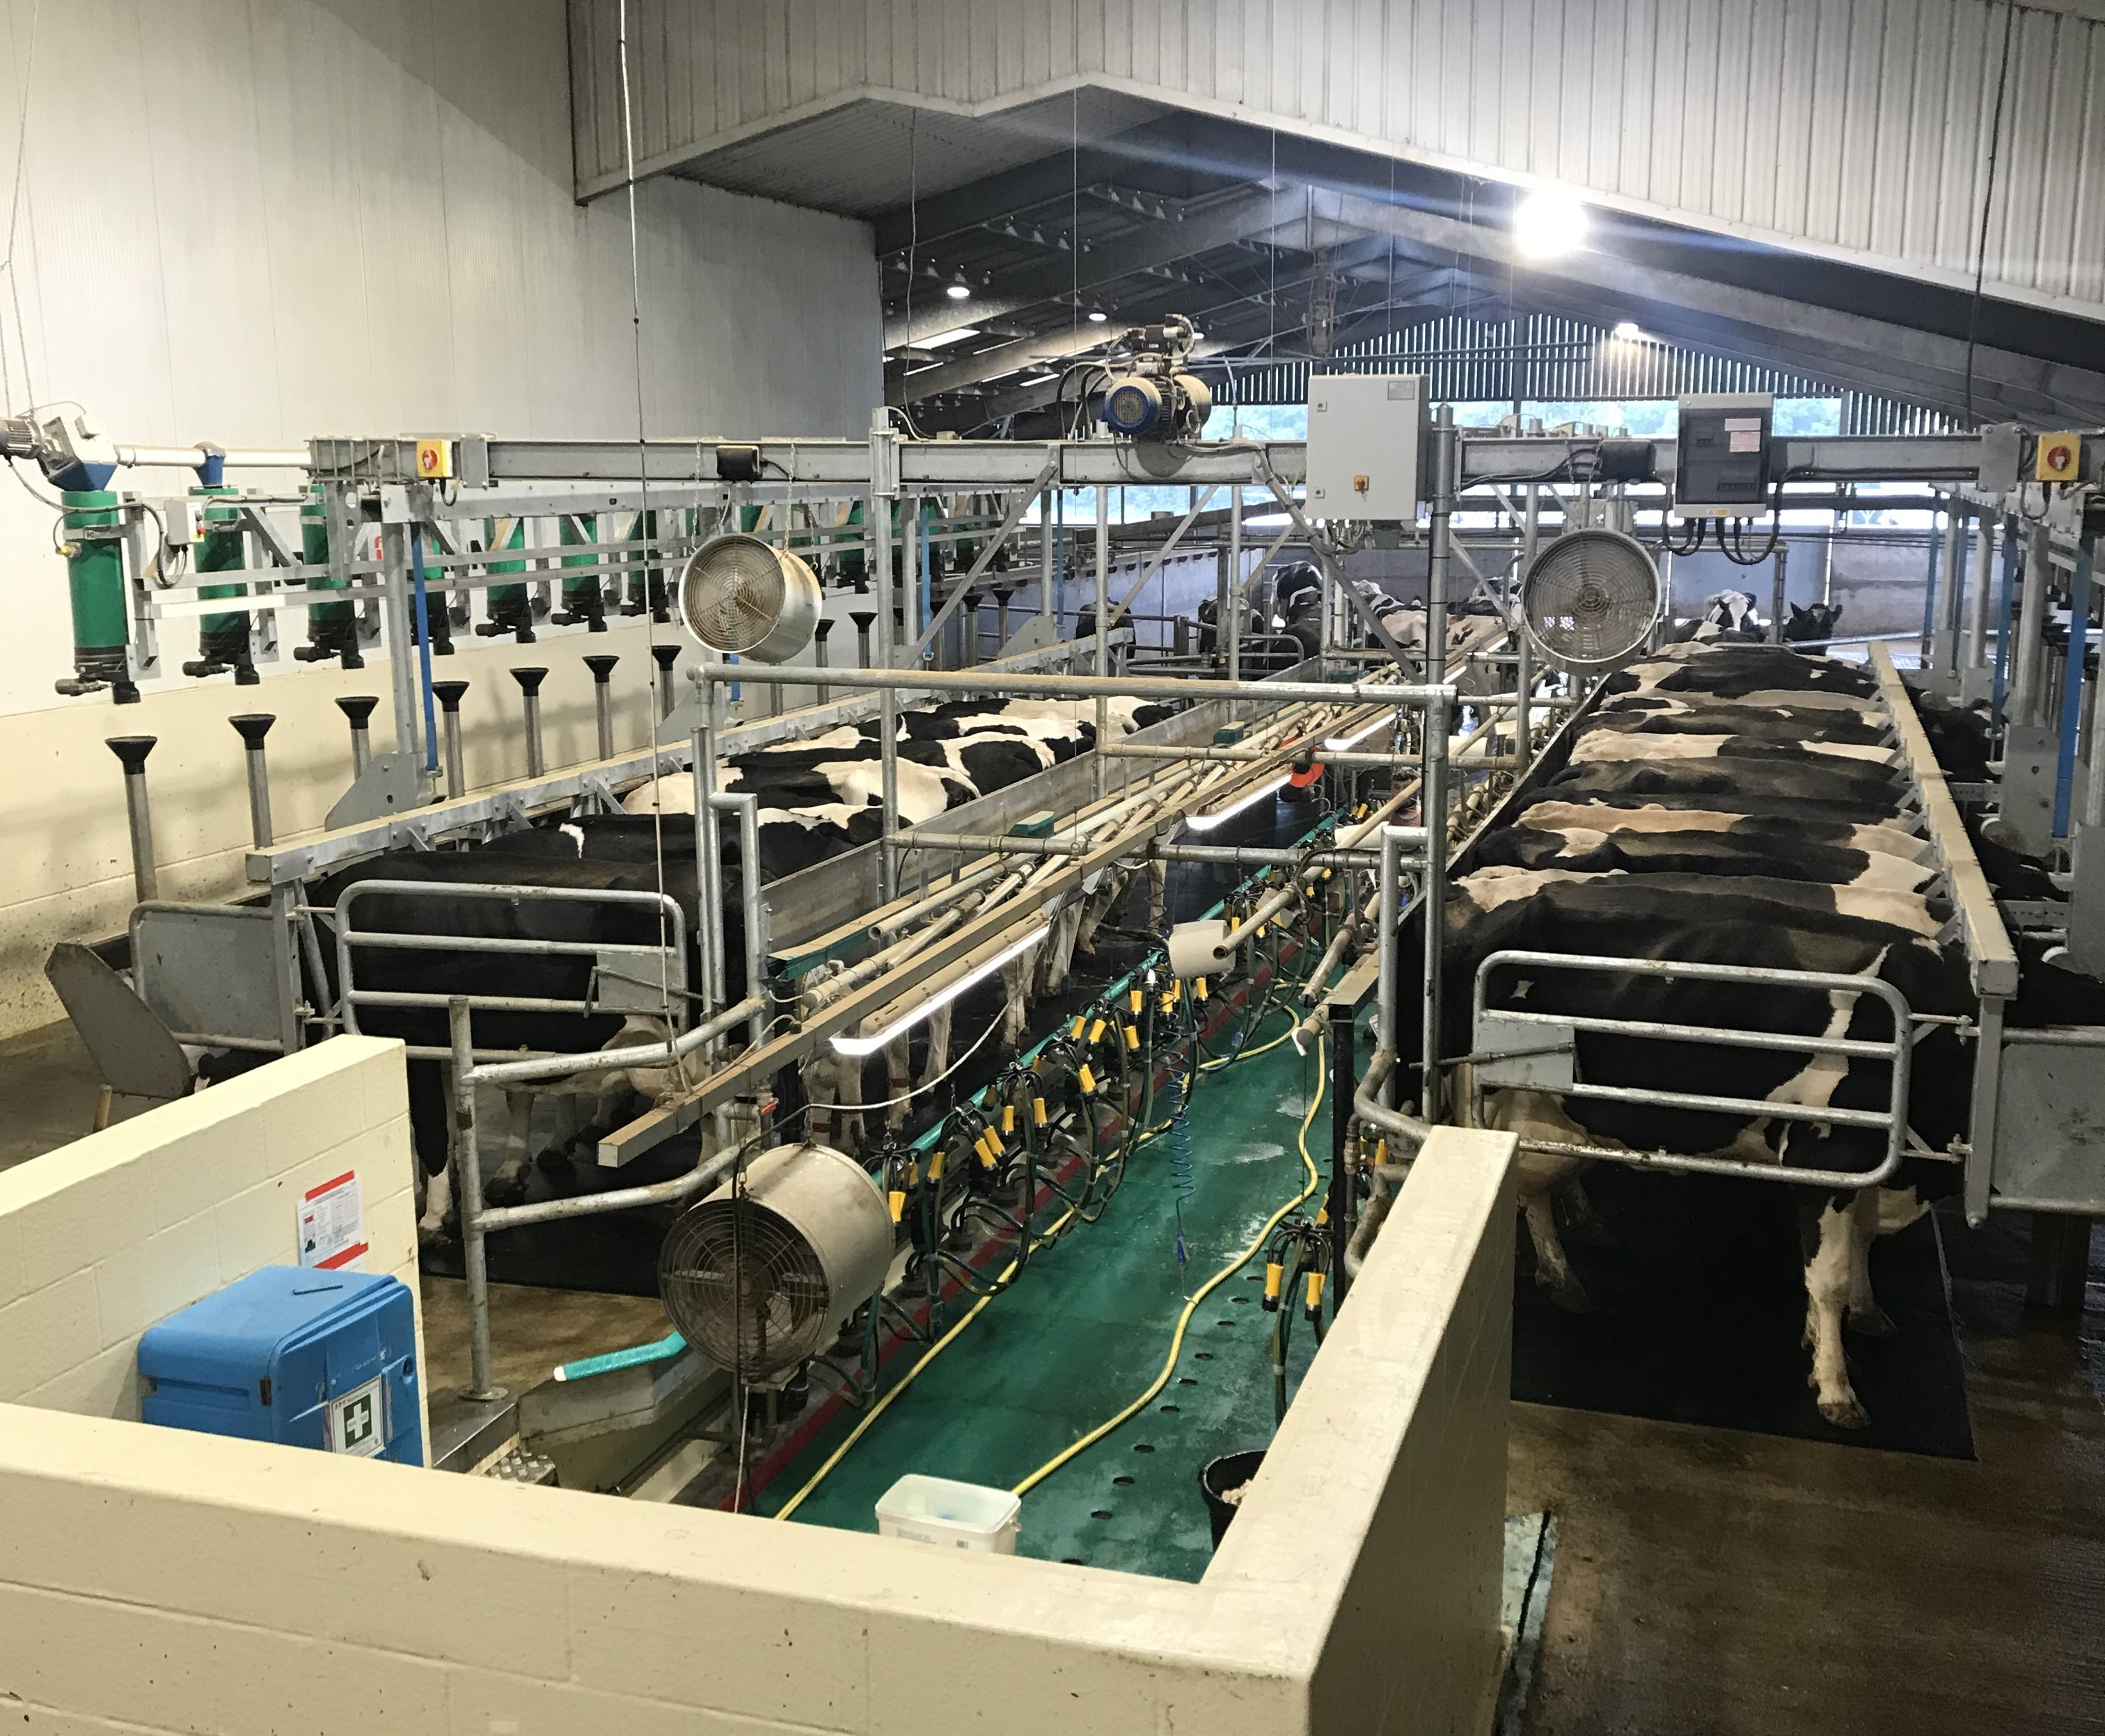
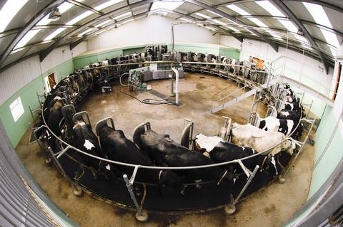
Commercial parlours
Two types
Herringbone (eg Hartpury College)
Holds 10 – 30 cows
Milking in batches (sides)
Rotary parlour (eg HAU)
Holds 40 – 100 cows at a time
Parlour rotates – difficult to attach sensors
C = First non-rotating position
Currently collecting data at C
May need to revisit for Robotic/AMS systems
C

Slide 25
Collecting milk temperature data - methods
Initial trials with data logged to SD card
Currently using Particle Boron’s as for THI/DHLI
Use 0.1% thermistors to measure temperature
V robust
V sensitive
?Calibration
Collect data v frequently and pre-process on MPU
Collect more frequently during milking times
Hardware - 16 bit ADC
Software – oversample to get to about 20 bit resolution
Determine median etc. to remove outliers

Slide 26
Preliminary milk temperature records
Milk temperature measured at milk pump exit
Clear patterns
High (>30’C) during milking
Drops <26 ‘C) between milkings
Hot water wash after morning milking
Cleans plant of milk residues
Morning milking cooler than afternoon
Propose
Cows at grass, sunny weather, DHLI rises
Core body temperature rises
Milk temperature rises
34.6
33.5
35.2
33.8
34.4
31.8
Feather M0 Adalogger

Slide 27
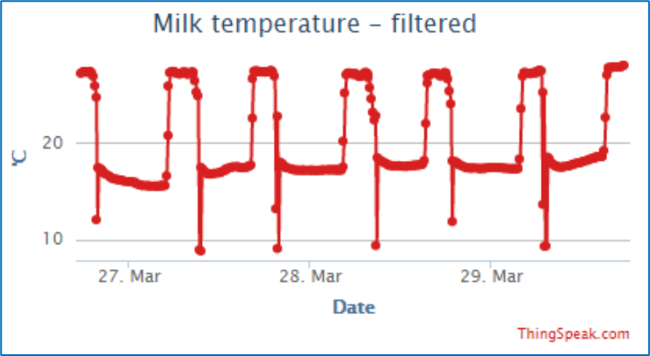
Automation of milk temperature collection
Where temperature taken – distance from udder.
Design of parlour
Pipe runs, flow speeds
Amount of milk in pipes
Ambient air temperature
temperature

Slide 28
Effects of heat stress Reduced feed intake + reduced milk output
Li (2019) fitted a quadratic regression
Li, 2019, QLD, AU

Slide 29
Effects of heat stress Reduced feed intake + reduced milk output
Signs of broken-stick response?
Is there a threshold?
Do these data suggest
No milk yield loss below THI 66
Linear loss as THI rises above 66
66
Li, 2019, QLD, AU

Slide 30
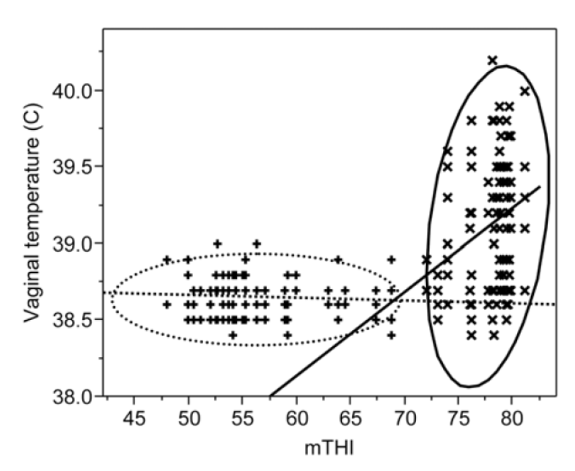
Effect of THI on vaginal temperature
Vaginal temperature v similar to core temperature
Cool period - Jan to Feb, MY = 24.8 l/day, n=5 cows
Hot period - Aug-Sept, MY 28.9 l/day, n=6 cows
Figure is for all 5+6 cows.
In cool period will assume all cows are always below THI threshold so have NO heat stress
Sensor resolution looks to be about 100 mK
Clear indication of a bent stick response
Hot period
Cool period
Nabenishi, 2011, SW Japan

Slide 31
Next stages
Use UK data
When do we get heat stress episodes
How does THI / DHLI change
How does this affect milk yield
How does milk temperature change
Relate milk temperature changes to
Changes in THI / DHLI
Changes in measured milk yield
Can we predict heat load from milk temperatures
A new, better index
Broken-stick regression or better methods
Deliver on-farm through edge processing

Slide 32
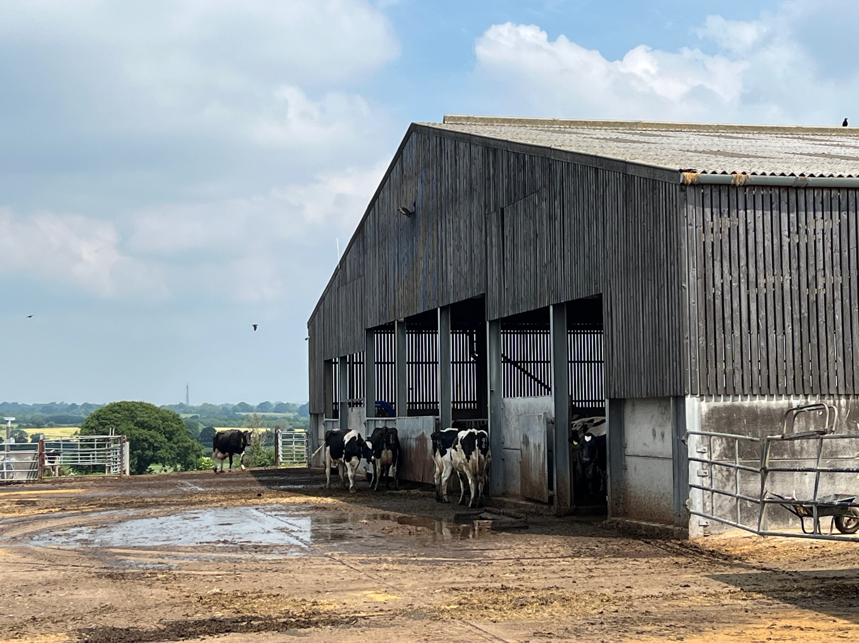
Thank you

